Slide 1
Kharif onion
Contribute about 20-25% of total onion production
Crucial for price stabilization
Maharashtra and Karnataka contributes 60% of total kharif areas

Slide 2
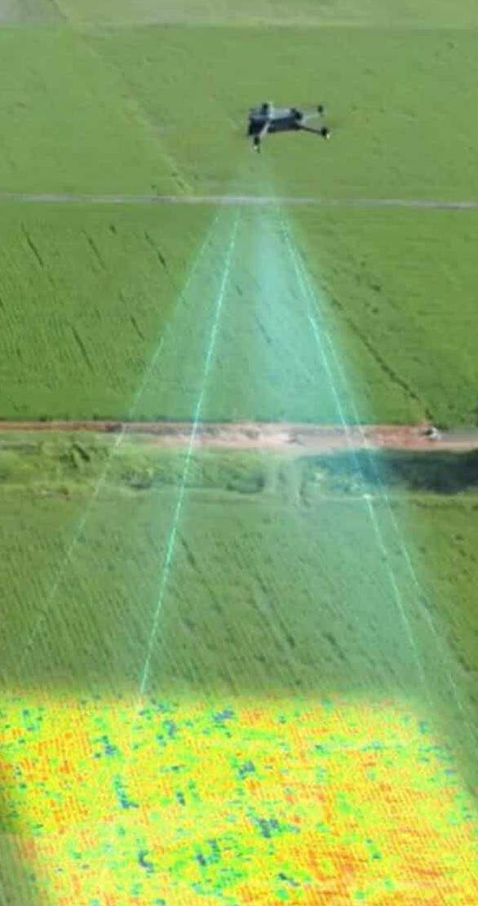
Pix4D mapper
Row Multispectral Images
Q-GIS
Vegetation map
Morphological data collection
Polygonal shape file
Correlations
Calculate Zonal statistics VI
Yield
Prediction

Slide 3
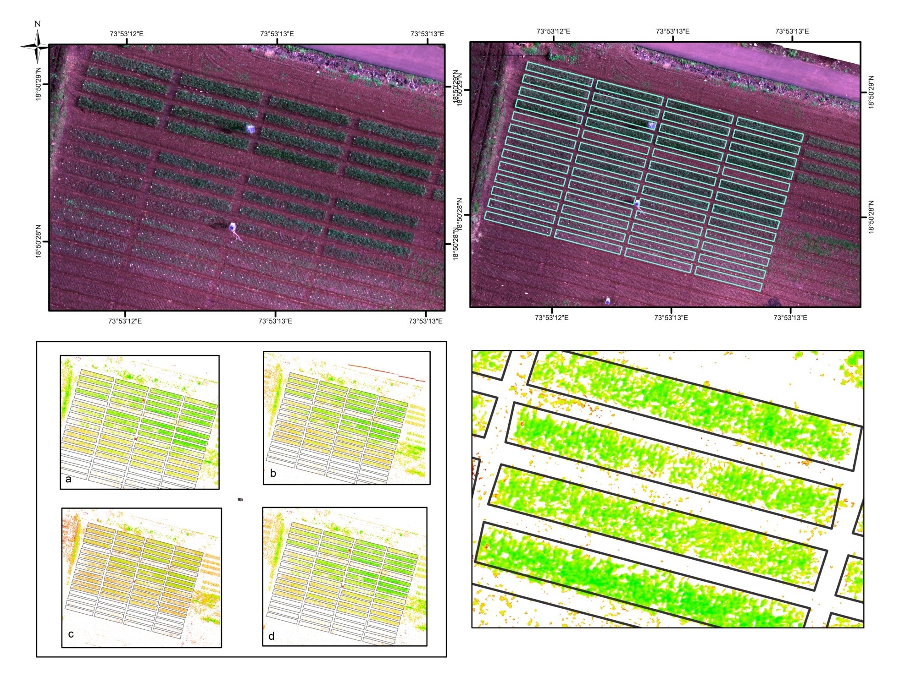
RGB orthomosaic of all UAV trials, shape file for this map is obtained from R, obtain varies vegetation indices, extract mean if all Vegetation Indices from each region of interest .

Slide 4
Vegetation Indices and Formulae
NDVI = (NIR - Red) / (NIR + Red)
NDRE = (NIR - Red Edge) / (NIR + Red Edge)
NGRDI = (Green - Red) / (Green + Red)
BGI = (NIR + Red) / Green
GLI = Green / (NIR + Red)
VARI = (Green - Red) / (Green + Red - Blue)
DVI = NIR - Red
SR = NIR / Red Edge
GNDVI = (NIR - Green) / (NIR + Green)
NORM2 = (Red - Green) / (Red + Green)
NORM3 = (Red - Blue) / (Red + Blue)
SAVI = ((NIR - Red) / (NIR + Red + L)) * (1 + L)
LAI = (3.618 * 2.5 * (NIR - R)) / (NIR + 6 * R - 7.5 * B + 1) - 0.118

Slide 5
Validating the Merging of Multiple Trials for Yield Prediction Using Machine Learning
Objective: Improve yield prediction accuracy by increasing sample size through trial merging.
Challenge: Each trial has only 15 observations, making individual modeling prone to overfitting.
Solution: Merging four trials to create a dataset with 60 observations, ensuring better generalization.
Justification for Merging Trials - Prevents Overfitting & Enhances Model Robustness
Small datasets (15 samples per trial) lead to models that memorize noise rather than learning patterns. Increasing the dataset size improves feature representation and reduces variance. (Wahab et al. (2022): Multi-season soybean yield prediction using UAV-based vegetation indices; larger datasets improve generalizability.)
Multi-Trial & Multi-Year Studies Use Similar Approaches. Many published studies merge multi-year or multi-location data to improve model training. (Zhang et al. (2021): "Cotton Yield Estimation Using UAV-Based Remote Sensing Data"; used 2-year dataset.)
PCA is used to reduce dimensionality in datasets with correlated variables while retaining as much variance as possible.
In this case, PCA is applied to spectral vegetation indices (NDVI, NDRE, SR, GNDVI, etc.), which are commonly used in remote sensing and agriculture for monitoring crop health, biomass, Yield prediction and stress conditions. PCA helps in selecting fewer indices that explain most of the variation, making analysis more efficient.
PCA Biplot of Spectral Indices seems that distribution along PC1 and PC2 suggests which indices contribute most to the variance in crop yield or vegetation status. Yield is influenced by multiple VIs, with NDVI, NDRE, and GNDVI being strong indicators.

Slide 6
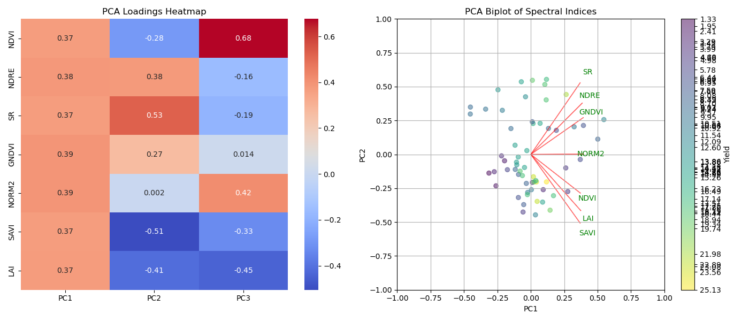

Slide 7
ML Evaluation Using Cross-Validation
Avoiding Fixed Train-Test Splits, Instead of using a fixed train-test split, employ 6-Fold Cross-Validation (K=6). Ensures all data contributes to both training and validation. (Breiman (2001): "Random Forests"; explains why cross-validation improves model reliability.)
Merging Trials is Scientifically Valid, Reduces overfitting risks from small datasets. Aligns with best practices in multi-season and multi-trial yield prediction. Use proper validation via K-Fold Cross-Validation.
The table provides key evaluation metrics based on cross-validation results (mean ± standard deviation) across different models.
R² (R-squared): Measures how well the model explains the variance in the target variable (Higher values (closer to 1) indicate better performance.), RMSE (Root Mean Squared Error): Measures the error magnitude in the same unit as the target variable (Lower values indicate better performance.) and MAE (Mean Absolute Error): Measures the average absolute difference between predictions and actual values (Lower values indicate better performance).
The table represents the standard deviation of the performance metrics across different cross-validation splits.
We evaluate the model multiple times on different subsets of data (e.g., 6-fold ). Each fold gives a slightly different result due to data variability. Standard deviation shows model stability: A high standard deviation (e.g., Decision Tree: R² = 0.55 ± 0.28) means the model's performance varies a lot across different test sets → less reliable model. A low standard deviation (e.g., Neural Network: R² = 0.72 ± 0.08) means the model is more consistent across different test sets → more reliable model.

Slide 8
Table 6. Validation of onion bulb yield estimation models with ML methods LR, DT, RF, SVR and XGBoost
Model | R² Score (↑ Better) | RMSE (↓ Better) | MAE (↓ Better)
Linear Regression | 0.37 ± 0.30 | 4.44 ± 0.84 | 3.59 ± 0.73
Decision Tree | 0.55 ± 0.28 | 3.60 ± 1.05 | 2.94 ± 0.78
Random Forest | 0.64 ± 0.13 | 3.31 ± 0.48 | 2.73 ± 0.53
Support Vector | 0.40 ± 0.15 | 4.48 ± 0.75 | 3.57 ± 0.45
XGBoost | 0.64 ± 0.09 | 3.42 ± 0.54 | 2.80 ± 0.58
Neural Network (MLP) | 0.72 ± 0.08 | 3.06 ± 0.67 | 2.53 ± 0.62

Slide 9
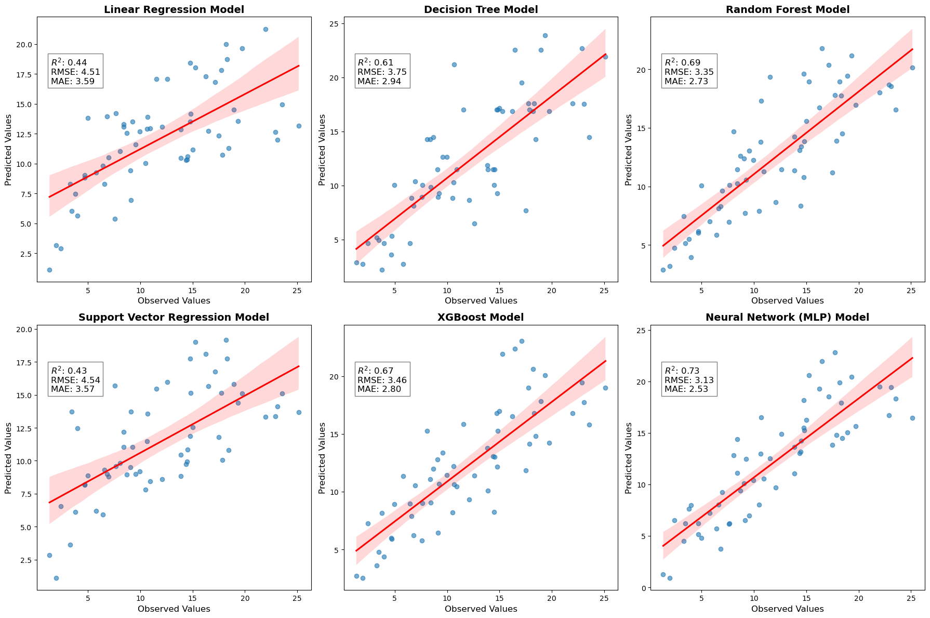

Slide 10
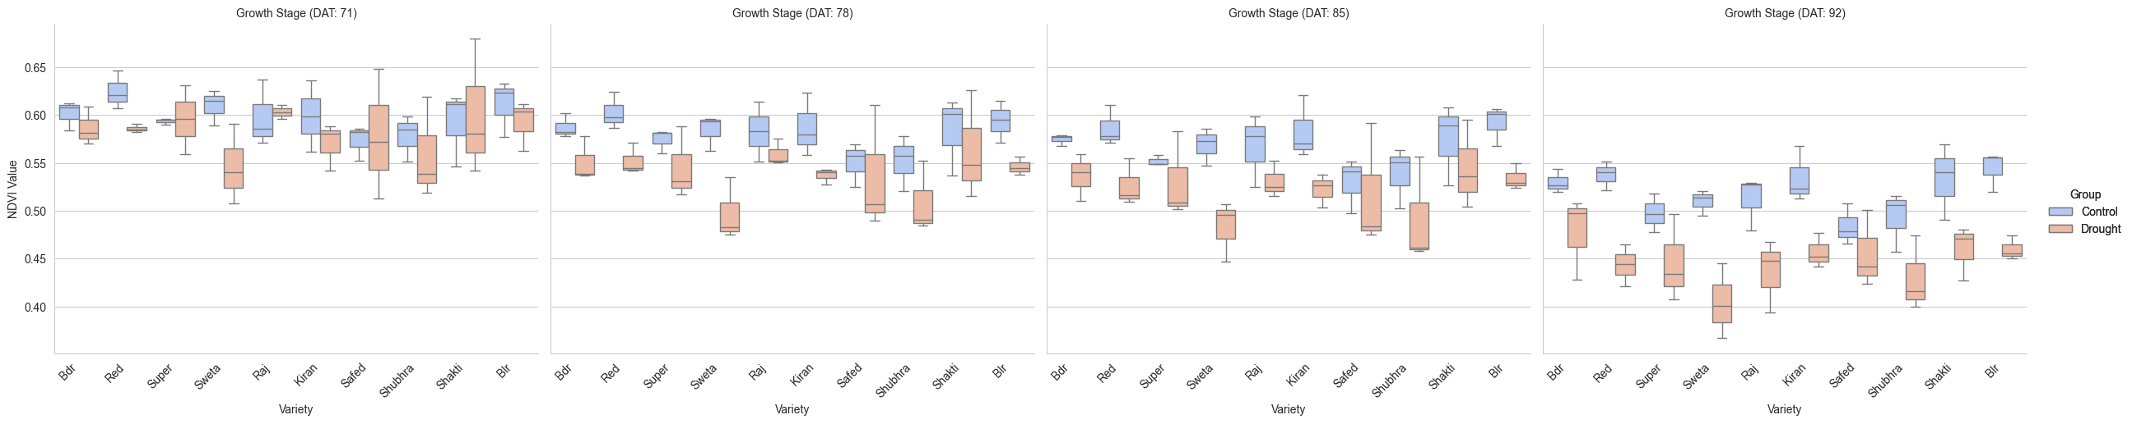

Slide 11
Next plan
Canopy height for general and abiotic stress phenotyping
Weather and various indices relationship
Stress specific reflectance

